Slide 1


Welcome to the seminar
Public Relations and Journalism for Adult Educators
Authors: Bianca Friesenbichler (CONEDU/Austria), Michael Sommer (Akademie Klausenhof/Germany)
Creative Commons Licence
Licenced under a Creative Commons Attribution-ShareAlike 4.0 International Licence.
Product of the project ‘Let Europe Know about Adult Education' (LEK-AE) funded by Erasmus+ / strategic partnership
2015-1-DE02-KA204-002327, responsible: Katholische Erwachsenenbildung Deutschland
Introduction 1
Slide 1

Slide 2
Parts of the seminar
1 Journalistic 'news value'
Selection and structure of information and concrete ideas for stories
2 Collection of relevant information
Information platforms and media in the field of adult education, interviews
3 Writing as a construction/constructive process
– between reality, stereotypes and PR
Values and attitudes in journalism, the relationship of truth, reality, objectivity and subjectivity
4 Using and writing for online media
Personal use of media, online versus print media, requirements of writing for online media
5 Making adult education more visible in media
European (online) media on adult education, making adult education more visible in media, writing journalistic texts and especially headlines and teasers/introductions
6 Writing good PR texts
Focus on facts and content, creativity and humour in texts, organisation of PR work
Slide 2
Introduction 2
Notes:
*Tip: After the pair work (task number 2) tell the participants to keep the information of the interview, because they will need it later.

Slide 3
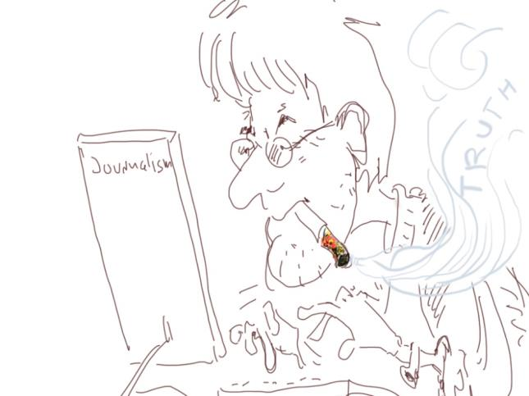
Journalism
means reduction
of complexity
Slide 3
Module 1

Slide 4
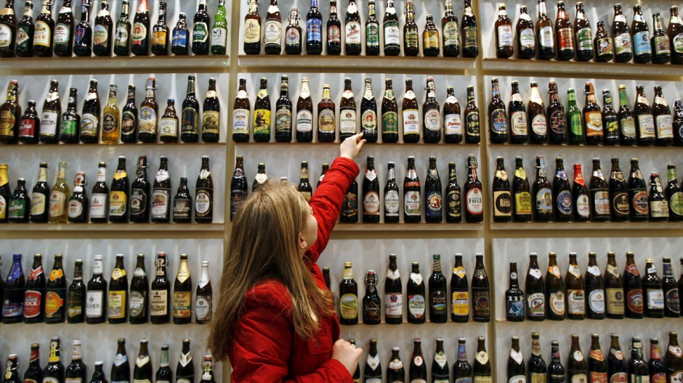
Dilemma of selection: Take one, forget all others
This one?
Or…
Slide 4
Module 1
Notes:
Reduction of complexity in journalism: As a journalist, you have to choose which aspects to leave out for your story. So you have to select and focus on specific aspects.

Slide 5
Dilemma of selection
very important/interesting
Important and relevant
not interesting/can be left out
…..
…
…
Notes:
Introduction for the participants: Everybody arranges the information about his/her interview, that they’ve collected before, in these three boxes and presents the important information to the plenum.

Slide 6
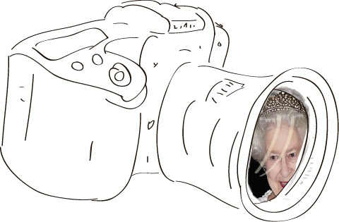
Journalistic
news value
Slide 6
Module 1

Slide 7
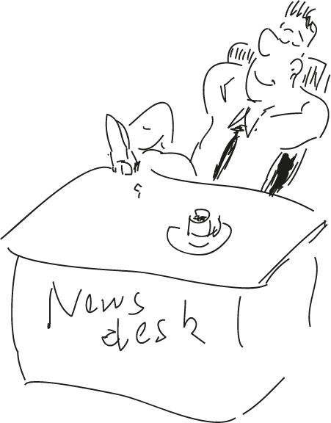
News value:
event
new
up-to-date
prominent person
disaster, accident
relevance
local event / proximity
negative / positive
unexpected, curious event
Slide 7
Module 1

Slide 8
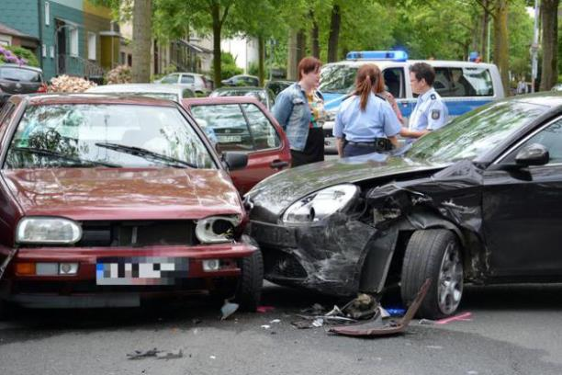
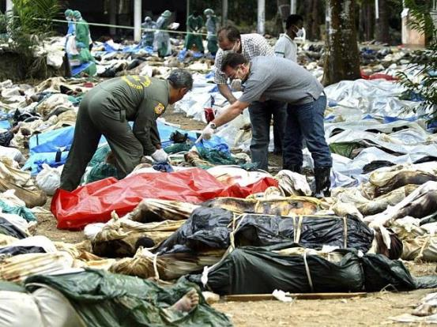
News value
Examples:
Proximity: Disasters in far-off regions need more victims than
local accidents…
Slide 8
Module 1 -2

Slide 9
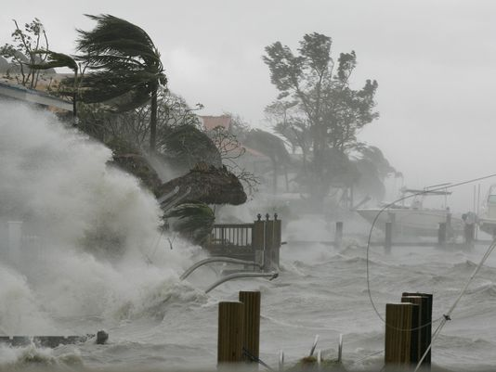
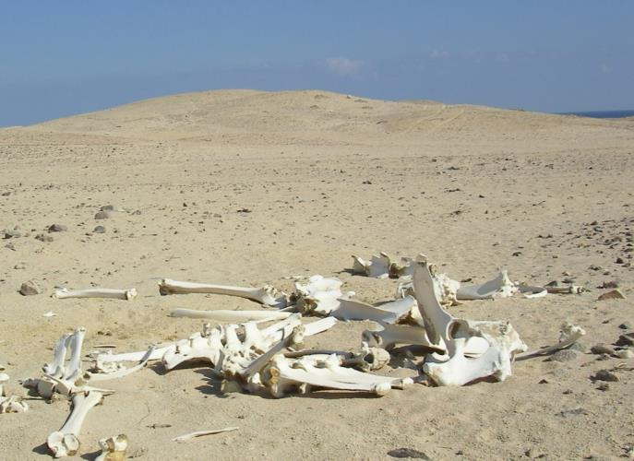
News value
Examples:
No event = no media story
Event = media story
Slide 9
Module 1 -3

Slide 10
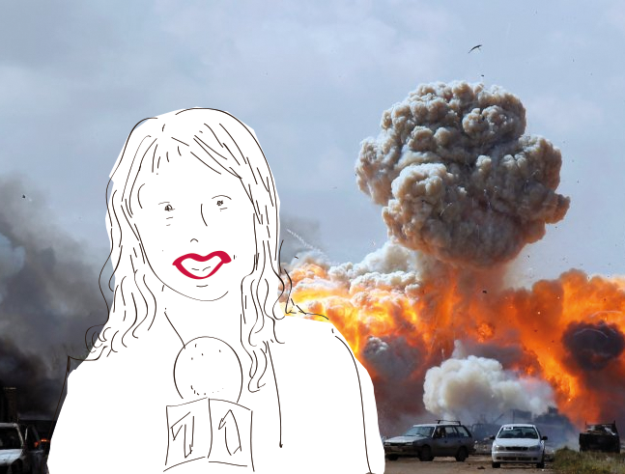
Module 2
Collection of relevant information
Slide 10
Module 2

Slide 11
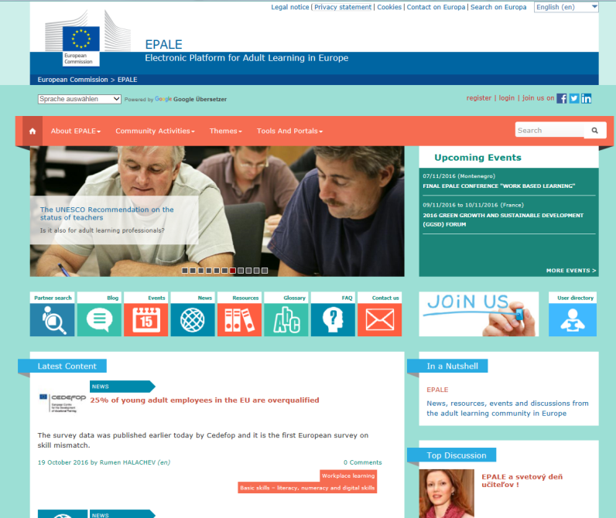
European and international platforms and media
EPALE (Electronic Platform for Adult Learning in Europe)
http://ec.europa.eu/epale/en
Platform paid for by European Commission
Multilingual
Community of adult educators
News / content by national partners and community contributors
Publication of own articles / events / blogs
Slide 11
Module 2

Slide 12
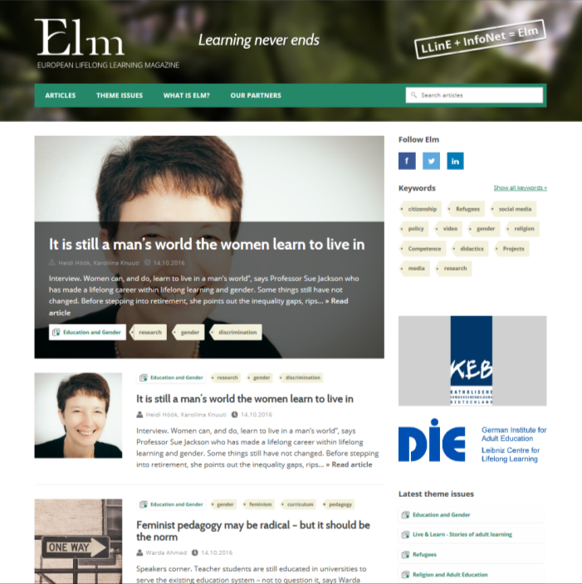
European and international platforms and media
ELM (European Lifelong Learning Magazine)
www.elmmagazine.eu
Journalistic online magazine (Finland)
Independent and professional
European network of contributors/partners
English
Publisher: Finnish Lifelong Learning Foundation (KVS)
Developed in the framework of former European InfoNet Adult Education (project partner of LEK)
Slide 12
Module 2

Slide 13
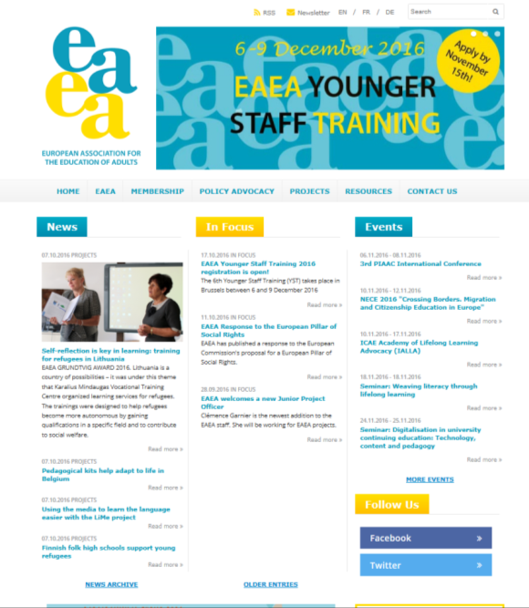
European and international platforms and media
Website EAEA (European Association for the Education of Adults )
www.eaea.org
Website of European adult education stakeholders
News (focus: policy sector)
EAEA matters
English / partly multilingual
Slide 13
Module 2

Slide 14
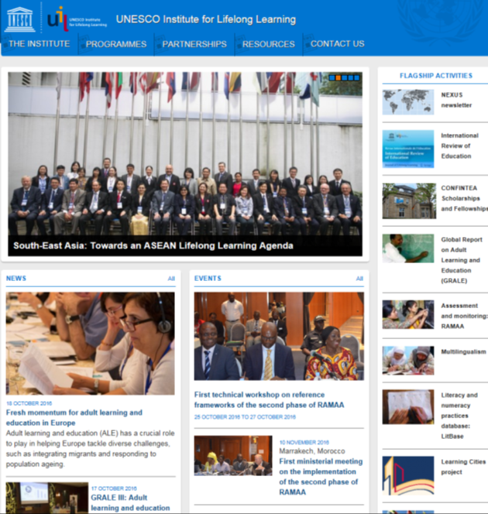
European and international platforms and media
Website UNESCO Institute for Lifelong Learning
www.uil.unesco.org/
Webpage of UNESCO institute
Focus: international activities and news
English
ALADIN, Adult Learning Documentation and Information Network
International Review of Education – Journal of Lifelong Learning
Slide 14
Module 2

Slide 15

European and international platforms and media
European Journal for Research on the Education and Learning of Adults (ESREA)
http://www.rela.ep.liu.se
Scientific journal (peer reviewed)
English
Publisher: European Society for Research on the Education of Adults (ESREA)
Slide 15
Module 2

Slide 16
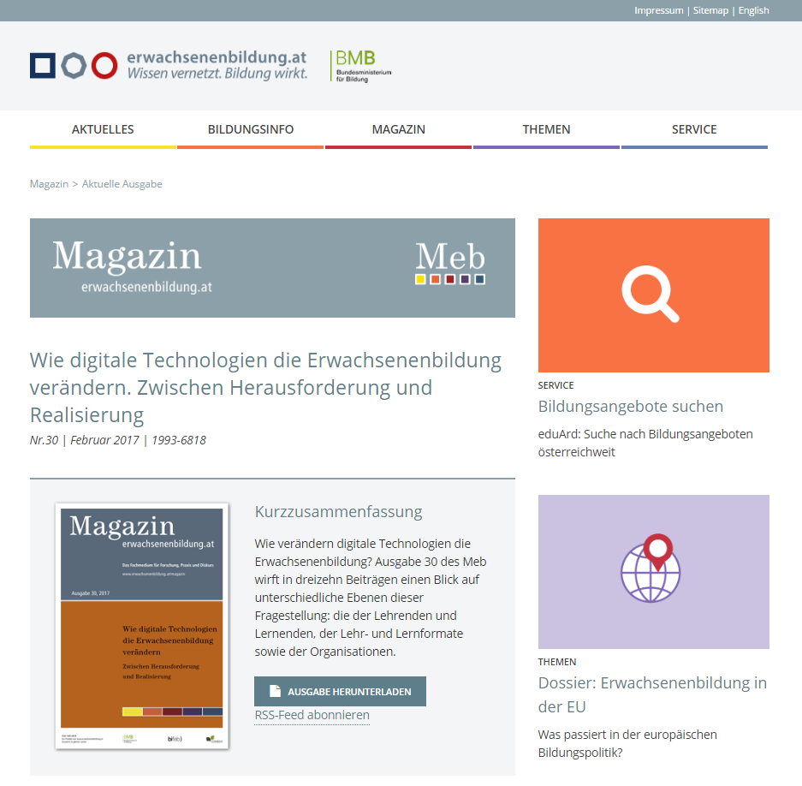
National / regional platforms
Example from Austria: erwachsenenbildung.at
www.erwachsenenbildung.at
Journalistic online magazine
German
Informs about education information systems, basic and current topics of adult education in Austria and the EU
Slide 16
Module 2

Slide 17
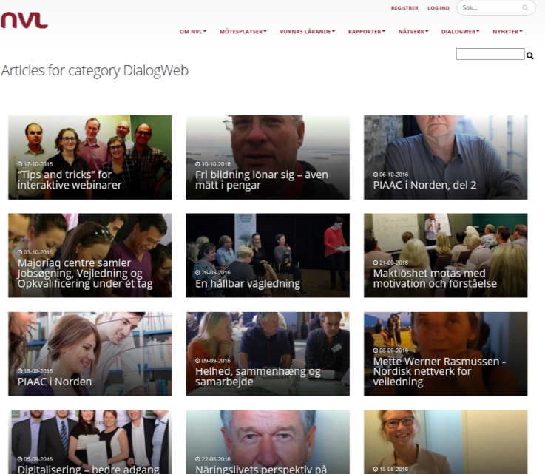
National / regional platforms
Example from Nordic countries: DialogWeb
http://nvl.org/DialogWeb
Thematic online publication
Nordic languages
Slide 17
Module 2

Slide 18
National / regional platforms
Example from xxxxx your country xxxxx
Slide 18
Module 2

Slide 19
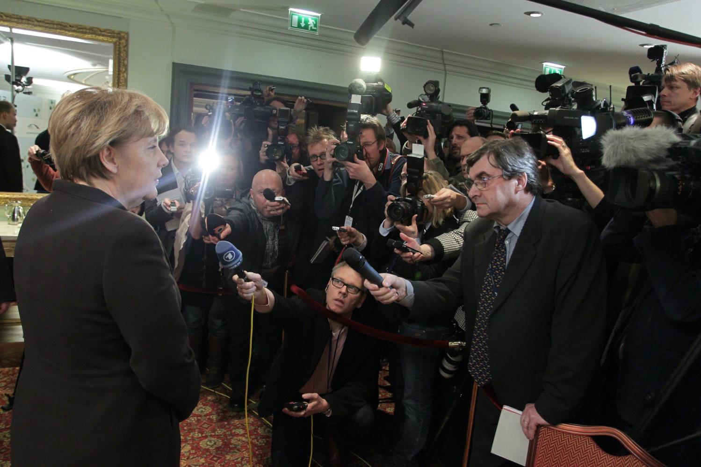
Lunch?
A mixed salad and pizza.
Interview
Slide 19
Module 2

Slide 20
Interview: methods
Sugar-coated questions
Competence field of interviewed person: ‘As an expert of xyz, what is your opinion?’
Confrontation
Critical aspects, contradictions: 'Why are you not …'
Confirmation
Integration of answer in the question: 'Do you agree that …'
Assimilation
Use of words, patterns, habits of person: 'You just said that … '
In-depth
Asking for details: 'What do you mean with …'
Slide 20
Module 2

Slide 21
How to give interviews
Correct answers, no lies
Concentration on relevant aspects
Focus on solutions/answers, not problems
Short and clear sentences
Only make evasive statements if necessary
Use slogans
Slide 21
Module 2

Slide 22
From the transcript to the text
Good questions – good answers
Remember: What is interesting/important? What contains news value?
Spoken language is different from written
Use quotes to make your text interesting
Slide 22
Module 2
Notes:
Good questions – good answers: Some questions lead to short and uninteresting answers. For example:
How long have you been working in basic education? – For five years.
This way would be better: How long have you worked in basic education and what has your intention been? – The answer might be quite more interesting.
Spoken language is different from written: Sometimes it’s not easy to read spoken language (because of anacoluthons or word repetitions). For readers it’s better to transcribe it.
Use quotes to make it interesting: A good quote could glue readers to your article. Perhaps you can manage to find an example in your language.

Slide 23
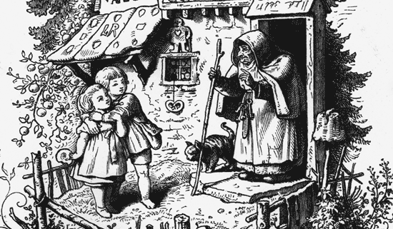
Module 3
Writing as a construction /
constructive process – between
reality, stereotypes and PR
Slide 23
Module 3

Slide 24
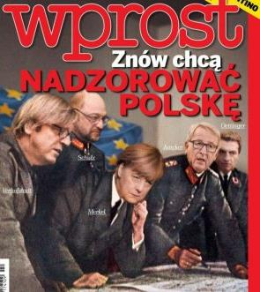

Manipulation
Photo montage: Merkel / Hitler
Fake reality: Plastic turkey
Slide 24
Module 3

Slide 25
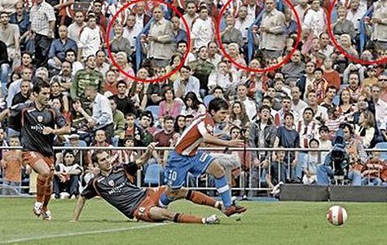
Manipulation
Photoshop manipulation
Slide 25
Module 3

Slide 26
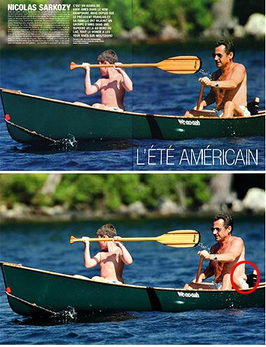
Manipulation
Beautification
Slide 26
Module 3

Slide 27
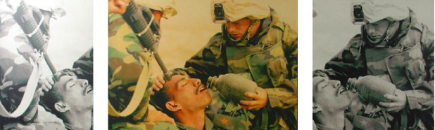
Manipulation
Manipulation by cropping
Slide 27
Module 3

Slide 28
News and propaganda
Propaganda (distributing lies) is not successful in free and democratic countries.
Journalists have to detect the interests behind the messages and avoid propaganda.
Propaganda and restriction of freedom of press are indicators for dictatorships.
Slide 28
Module 3

Slide 29
All reports and news are subjective, objectivity does not exist.
Messages of the government, institutions … are always steered and have an intention.
' Information, unlike what the myth of objectivity and the mirror metaphor say, is not a mere reflection of reality. It is constructed on the basis of selection judgments and priority setting criteria that determine what the informant deems to be newsworthy and interesting to the audience.'
MONIÈRE, Denis. (1999). Démocratie médiatique et représentation politique, Presses de l’Université de Montréal, Montreal.
https://www.linkedin.com/pulse/constructivism-other-theoretical-communication-models-mbengue

Slide 30
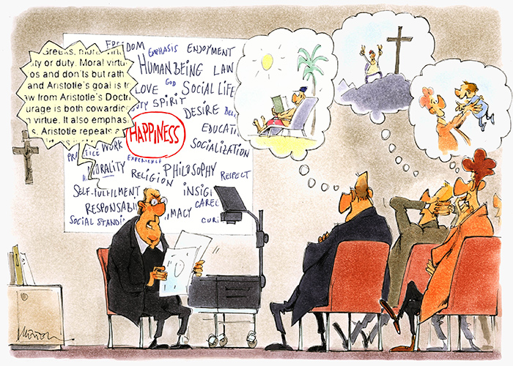
Constructivism in journalism / AE
‘Despite the same surroundings, everybody does live in different worlds.’
Arthur Schopenhauer
Slide 30
Module 3
Notes:
Current news do not have intrinsic content and meaning. Only the reader gives meaning to the news. And this meaning depends on the experience and the beliefs of each reader. Everybody creates his/her own reality. For further information see also https://www.learning-theories.com/constructivism.html

Slide 31

Patterns of public relations
Successful
Brilliant
Fantastic
Smart
Use of adjectives
Highlight positive aspects
No critical elements
Call to action
Slide 31
Module 3

Slide 32
'Public relations is a strategic communication process that builds mutually beneficial relationships between organizations and their publics.’ (PRSA 2011-2012)
Definition: Public relations (PR) is the way organisations communicate with the public and media. The aim of PR is to create a positive image of the organisation and a strong relationship with the audience. http://www.ipr.org.uk
Examples: press releases, newsletters, public appearances, etc.
PR ≠ advertising: While advertising is exclusively focused on the promotion of products or services with an aim to encourage target audiences to buy, PR is specialised in the communication with the public and media. http://www.ipr.org.uk/pr-vs-advertising.html
Slide 32
Module 3
Notes:
For further information see also:
http://www.ipr.org.uk
https://www.entrepreneur.com/encyclopedia/public-relations
http://apps.prsa.org/AboutPRSA/publicrelationsdefined/

Slide 33
Module 4
Using and writing
for online media
Use of media in Europe / Facts and figures
Slide 33
Module 4

Slide 34
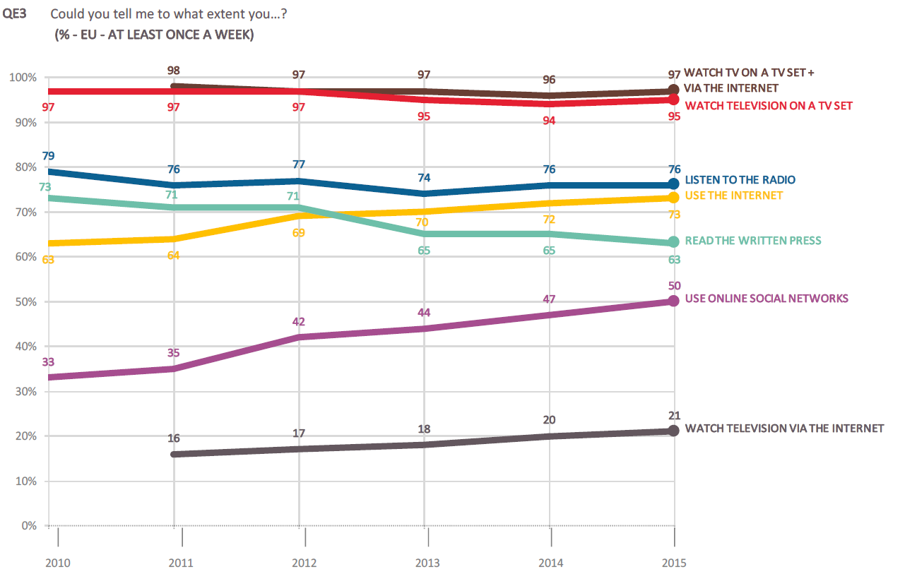
Use of media in Europe / facts and figures
Decline of reading written press
Source: Standard Eurobarometer 84: Media use in the European Union (Year 2015)
Slide 34
Module 4/2

Slide 35
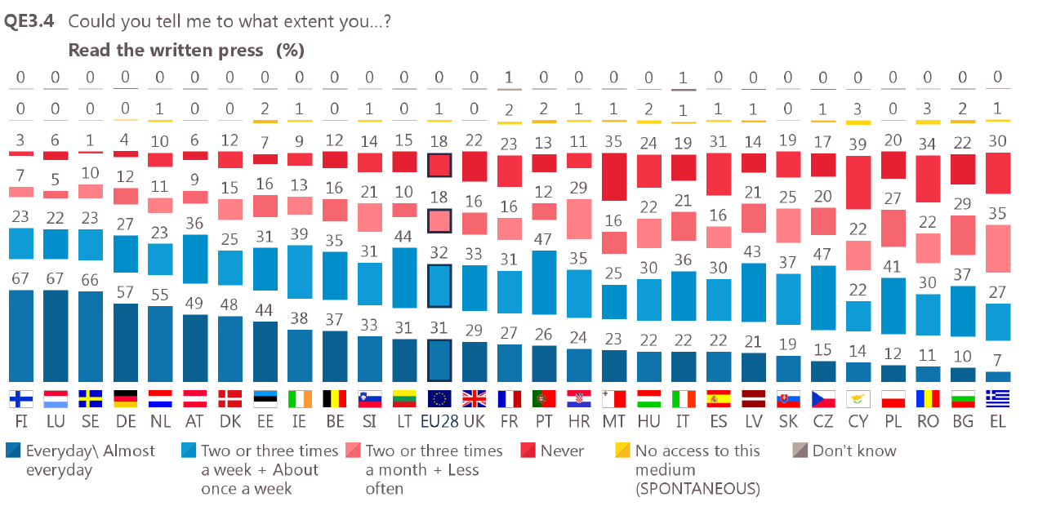
Wide divergences between Member States
Use of media in Europe / facts and figures
Source: Standard Eurobarometer 84: Media use in the European Union (Year 2015)
Slide 35
Module 4/3

Slide 36
Structure of media
Press: daily newspapers, weekly newspapers; regional/national press
TV, radio: commercial/public
Internet as an alternative information source
Slide 36
Module 4
Notes:
Information for the trainer:
The structure of media varies across countries. You could add specific information for your country. For Austria, information is available at http://archiv.bundeskanzleramt.at/DocView.axd?CobId=57669 and http://www.demokratiezentrum.org/fileadmin/media/pdf/steinmaurer2.pdf as well as on http://www.politischebildung.com/pdfs/35steinmaurer.pdf

Slide 37
Online reading is different to reading printed media
Online readers…
… skip and skim information
… jump from one to the next headline
… spend little time on the site
… prefer clicking links instead of reading to the end
… do not like long texts – online reading is more exhausting than reading print media
Slide 37
Module 4
Notes:
Information for the trainer:
Readers skip and skim information: They fly over the text and examine which information may be interesting. They don‘t read a text from the beginning to the end.
For further information, see also https://www.usability.gov/how-to-and-tools/methods/writing-for-the-web.html

Slide 38
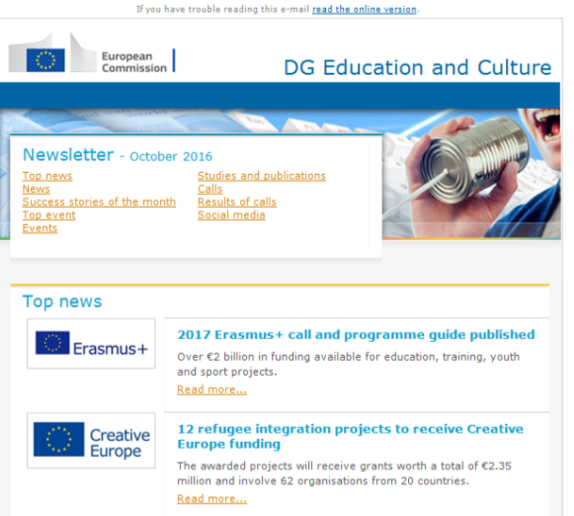
Which media for which content
Websites
For all relevant information
Download area/press area for journalists
For campaigns
News channel possible (makes change and development visible)
Newsletters
For spreading news and activities
For flexible use (interval, for spreading a
specific topic/event)
Example: Newsletter of the DG Education and Culture / European Commission
Slide 38
Module 4

Slide 39

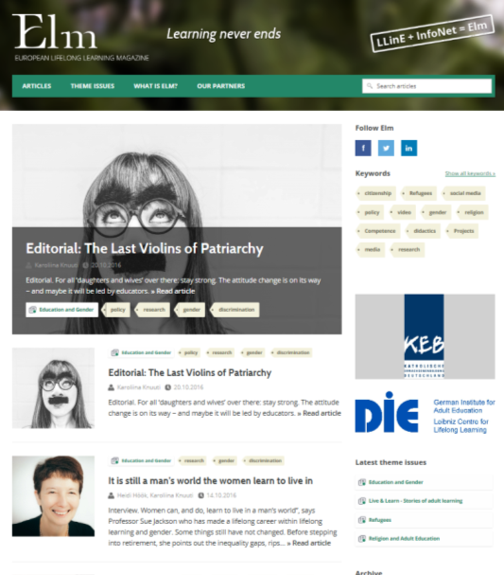
Which media for which content
Online journals
Are often open-access media (take care of what CC licences mean)
For broad dissemination
For scientific or practical articles (neutral, reflected, no PR speech)
Examples:
Online Journal of Distance Learning Administration
European Lifelong Learning Magazine
Slide 39
Module 4

Slide 40
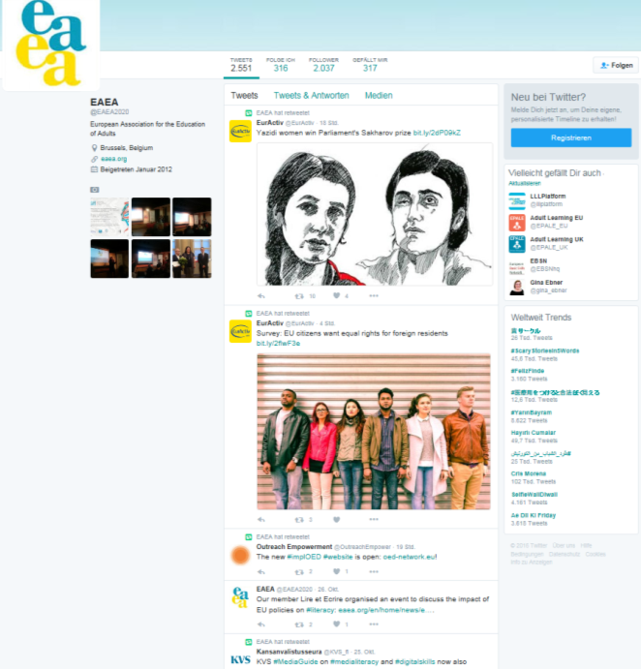
Use of online media
Using social media
Facebook
as marketing channel for companies
as a place for 'family stories'
to share interesting photos
to share different messages than on
website news (such as blogs)
Twitter
as a journalists’ platform (most of the
journalists and politicians use it)
as a place for very fast news
(such as during events)
Example: Twitter account European Association for the Education of Adults EAEA, @EAEA2020
Slide 40
Module 4

Slide 41

Module 5:
Making
adult education
more visible
in media
Slide 41
Module 5/1

Slide 42
Basic journalistic principles
Answers to basic questions:
When, where, who, what, how, why?
In news story: Try to be objective, no own opinions, no adjectives
Understandable, true/correct, detailed
Interesting story
Slide 42
Module 5/2

Slide 43
Basic journalistic principles
Examples/options for a first sentence
Statement in quotes: 'This is the first time, that men have walked on the moon', said the President of the United States.'
Exact figures: 'At 4:17, Neil Armstrong took the first step on the moon.'
New/extraordinary element: 'It was a historical moment – the first step of a man on the moon.'
Relation to local/regional: 'All inhabitants of Helsinki excitedly looked to the moon. Today, they are witnessing an historic moment: the first step on the moon.'
Report-like introduction: 'It was cold. Minus 120 degrees. Dusty but streaming sunlight. This was the moment Neil Armstrong made his first step on the moon.'
Slide 43
Module 5/3

Slide 44
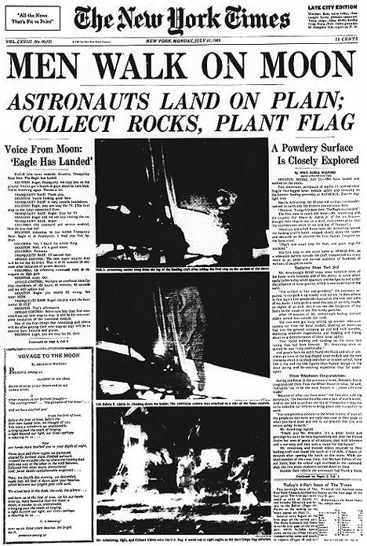
Basic journalistic principles
Men Walk On Moon
Astronauts Land On Plain; Collect Rocks, Plant Flag
By John Noble Wilfordouston, Monday, July 21
Two Americans, astronauts of Apollo 11, steered their fragile four-legged lunar module safely and smoothly to the historic landing yesterday at 4:17:40 P.M., Eastern daylight time.
Neil A. Armstrong, the 38-year-old civilian commander, radioed to earth and the mission control room here:
'Houston, Tranquility Base here. The Eagle has landed.'
Example: exact figures
Slide 44
Module 5/4

Slide 45
Basic journalistic principles
Writing a good news story
Focus on most important matter
Present details
Use statements (in quotes)
Include critical aspects / different point of view
If possible: describe circumstances, create ‘images in the reader’s mind’
Slide 45
Module 5/5

Slide 46
Online readers…
Online writers…
… skip and skim information
… jump from one to the next headline
… spend little time on the site
… prefer clicking links instead of reading to the end
… do not like long texts – online reading is more exhausting than reading printed media
… should give attention to headlines, structure, teasers and keywords
… should use subheadings
… should write most important matter at the beginning
… should decide which links they choose
… should use short sentences, active speech, verbs instead of nouns, and address readers directly
Slide 46
Module 4
Notes:
For further information, see also https://www.usability.gov/how-to-and-tools/methods/writing-for-the-web.html

Slide 47
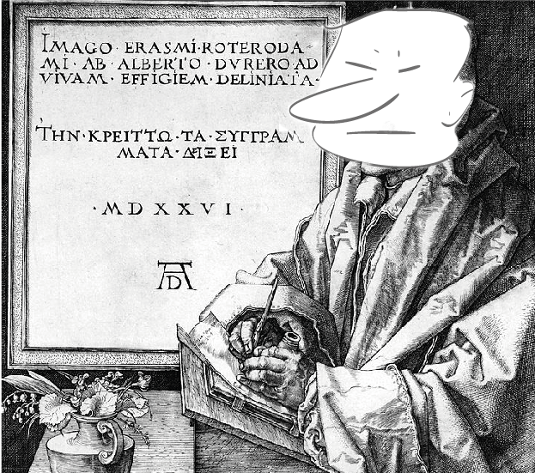
Module 6:
Writing
good
PR texts
Slide 47
Module 4/6

Slide 48
Writing good PR texts
Creativity techniques
Creativity and humour make texts enjoyable and entertaining and produce an emotional connection to the reader.
Techniques for finding stories to push a topic: brainstorming, -writing, -walking; mind maps; ABC method; images in the mind; spontaneous drawing; picture cards;
Techniques to find humorous titles, brilliant puns: using surprise and contradictions, call-backs, join poetry slams, take the opposite side (satire)…
Slide 48
Module 4/6

